Slide 1
La Crosse County’s largest food pantry, “Feeding People, Providing Hope” since 1986
Notes:
Mission Statement: Responding to God’s love, WAFER provides food and works to eliminate hunger.
At inception, WAFER (known then at West Avenue Food Emergency Resource) was housed in the basement of St. Paul’s Lutheran Church and serviced by UW-L Campus Ministry and Roncalli Newman Center. In 2002, WAFER moved to its location on Causeway Blvd keeping the WAFER acronym, dropping the wordy title. As needs increased WAFER staff responded by adding more donors, coolers, vehicles, and equipment. Eventually outgrowing the Causeway Blvd location, a former grocery store on La Crosse’s north side was purchased and renovated. The new facility was opened in May 2023. Today, WAFER employees eleven part-time staff and relies on hundreds of volunteers to serve 15+00 families each month. In 2024, more than 40,000 people were fed for ~4 days. An estimated 1,500,000+ meals were put directly on the table for those who need it most.
Our work is made possible because of our generous donors, volunteers, and supporters. Thank you for supporting WAFER, the mission to feed people, and for feeding people in need.

Slide 2
Notes:
When WAFER opened its door in 1986, families were able to receive one food package per year on an emergency basis. In 1986, 3366 food packages were given out. In 2002, WAFER became a TEFAP outlet (the government commodities program). To follow government program regulations, families were now able to come at least one time per month. During 2008, when our country entered the recession and many people lost jobs or had reduced wages/hours, WAFER experienced a spike in needy families. In 2008, 11,155 food packages were distributed and peaked in 2011 at 20,180. In 2025, need remains elevated as families continue to struggle with having enough food to put on the table. Continued food insecurity, affecting people locally, is the precise reason why WAFER exists.

Slide 3
Who comes to WAFER?
Notes:
La Crosse County’s poverty rate is at ~12%. Poverty knows no age, race, or gender. We serve a variety of people in a variety of situations; working families, single-parent households, military families, veterans, the homeless, seniors, those with disabilities, and much more. In an effort to address hunger needs within specific populations WAFER has implemented several programs in addition to our “Food Share” food package distribution.
Senior Share is a “food package delivery” program for those 60+ and is entering the fourth year of service. Food packages are packed for dietary needs or individual preferences when possible and contain ~4 days worth of food. In addition to canned goods, Senior Share boxes contain eggs, bread, and frozen meat. Food packages are delivered by staff and volunteers to senior housing complexes, meal sites, town hall, and individual residences. Senior Share is available to all communities in La Crosse County.
In collaboration with the Bangor School District, September 2013 began a student food program over the weekends. Teachers refer children to this program based on indications that they don’t receive enough food over the weekends. The food varies based on availability, but staff tries to plan out well balanced meal kits. They typically contain a minimum of two meals and two snacks per day.
In 2017, the Mobile Food Pantry program was implemented as a way to reach people unable to get to our main pantry location due to transportation or physical limitation barriers. Today, the Mobile Pantry distributes over 2000 food packages annually and stops at 20 unique site monthly. Stops include low income housing complexes, identified food insecure neighborhoods, churches, schools, community centers, other service provider organizations, and more. Scheduled stops, dates, and times can be found on the WAFER website under the Calendar.
In coordination with community partners, such as UW Extension FoodWIse Nutrition Educators, Emplify Dieticians, and Mayo Health System Dietitican, WAFER hosts monthly nutrition education sessions which provide participants with helpful tips, recipes, skills, and kitchen tools to implement health choices and healthy cooking at home.
The nearly 20 year long program specific to the Hmong and Asian populations has been offered for families to provide more culturally relevant foods such as bamboo shoots, fish sauce, rice, and rice noodles. Hmong families account for approximately 10% of all families served.

Slide 4
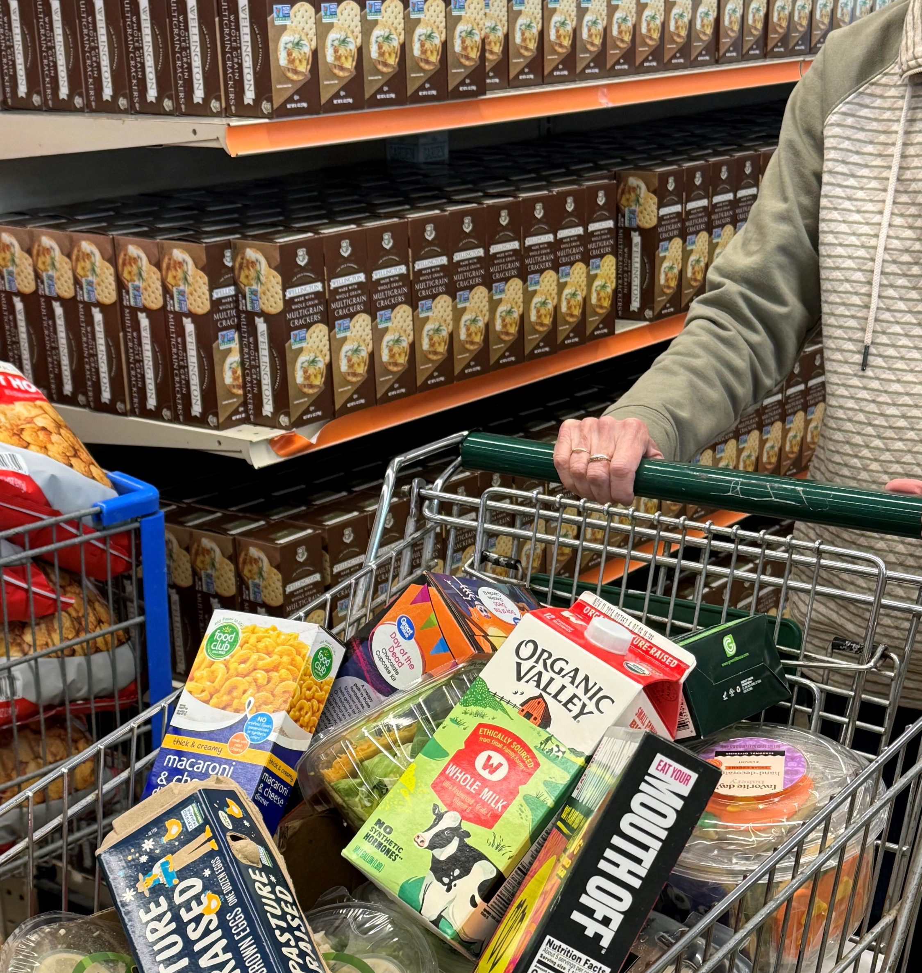
What is in a food package?
Notes:
This is a food package for a household of one to two people. It contains a variety of self-selected canned goods (such as fruit, vegetables, spaghetti and sauce, soup, cereal, tuna, peanut butter, mac-n-cheese, and canned beans), fresh produce (tomatoes, apples, oranges, bananas, corn, peppers, potatoes, green beans, lettuce salad), dairy (eggs, yogurt, hummus), breakfast sausages, baked goods (muffins, loaves, and buns), personal hygiene, and frozen meat.

Slide 5
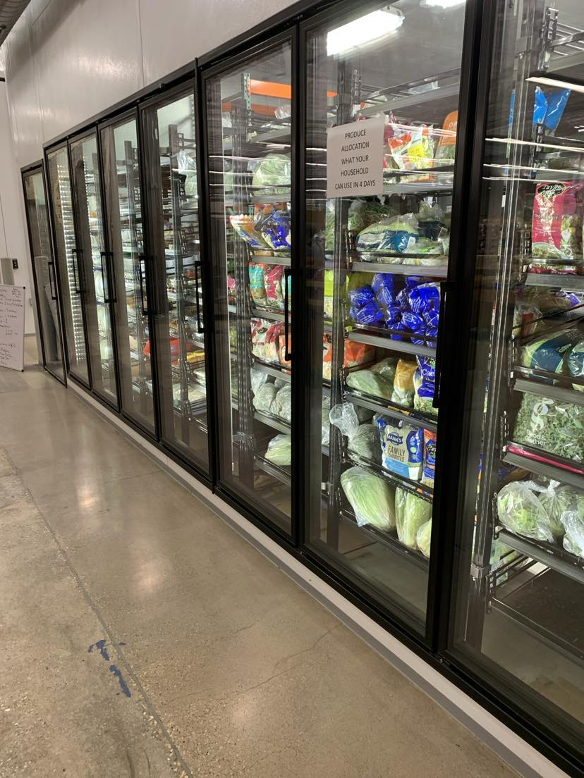
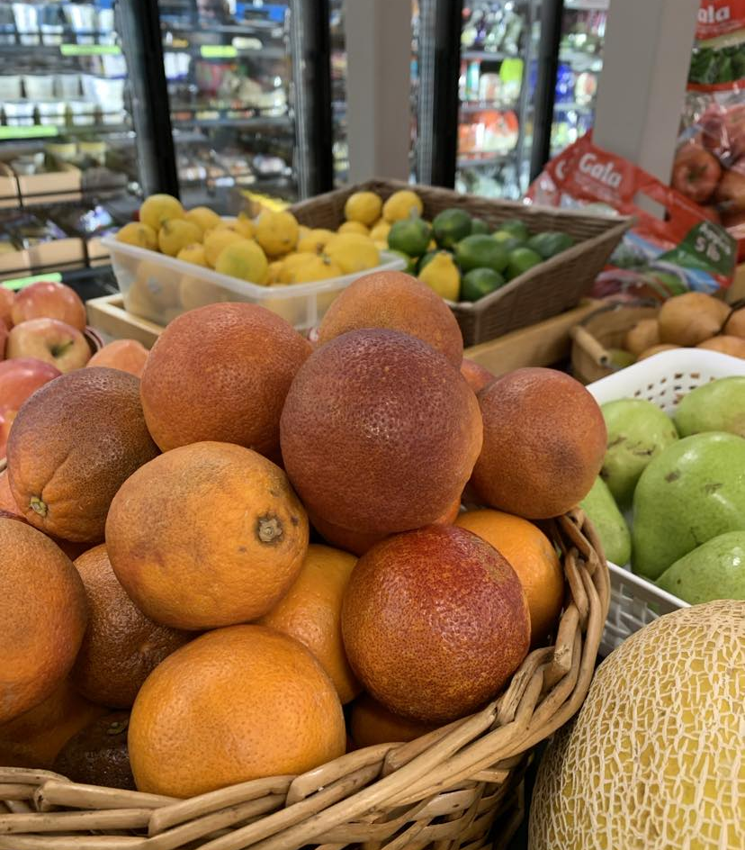
Where does the food come from?
Notes:
Each month, WAFER collects, purchases, rescues, and distributes more than 100,000 pounds of food. To put that number into something tangible, in one month we give out 6000 cans of soup and 4000 jars of peanut butter. In order to offer a well balanced food package, we obtain food through a variety of sources.
WAFER is largely supported by some local retailers weekly; Walmart, Sam’s Club, Westby Creamery, Kwik Trip, Target, Linda’s Bakery, Starbucks, and Panera. These donors supply our families with a nice variety of fresh produce, baked goods, dairy, and meat. In 2021 this accounted for ###% of total food distributed.
As a TEFAP (The Emergency Food Assistance Program) outlet, we receive government commodities. These vary from month to month depending on what the government has had access too. We typically receive frozen meat, cereal, canned vegetables and fruit, and pasta. In 2021, this accounted for ##% of all food distributed.
Individuals, businesses, clubs, and churches accounted for ##% of the food given out in 2021. This was in the form of a food drive, collection at a work place, weekly collection at church, collecting at an event, competition between service clubs, a child who collected food at their birthday party instead of getting gifts, and much more.
Food Rescue plays a large part in our operations. Included under number 3, WAFER actively seeks product that might otherwise be destroyed due to rejection at the retail level due to over shipment, a dented box, mislabeling, or one little piece of produce that is imperfect. We accept trucking company donations or send our truck to a load that is to be donated.
To ensure a complete food package to each family on each visit, WAFER must purchases approximately one-third of the total food given out in the standard food package. Staff search for the best deal from a variety of sources (local retailers, warehouses, foodbanks, etc) in order to get the most bang for our buck. The items we frequently purchase are man-n-cheese, tuna, soup, cereal, and peanut butter.
Supporting various anti-hunger programs and organizations by sharing has increased in recent years. WAFER provides food to community meal programs and local pantries. In 2021, 30,000 pounds of food (typically in the form of dairy products, produce, meat, and bakery) was shared.

Slide 6
How can you help?
Donate food or make a monetary donation to purchase items in low supply.
Organize an event or food drive, standard or theme specific.
Volunteer
Notes:
Over the years, supporters have chosen a variety of ways to raise food or funds for WAFER.
Various clubs and groups donate a portion of the proceeds from events they are holding. Recent events include car shows, concerts, and raffles.

Slide 7
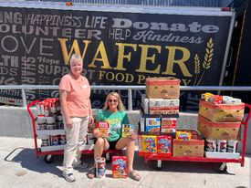
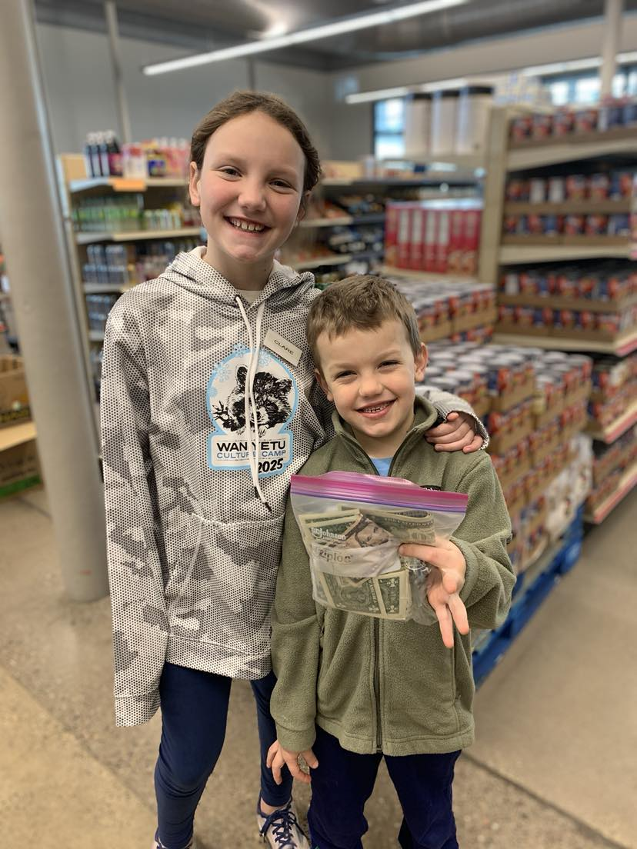
Donate.
The Rock 95.7 FM at Midwest Family Broadcasting heard WAFER was short on breakfast items. With access to impact funds, they purchased cereal, oatmeal, and pancaked mix.
The Fritts Family volunteers regularly. Clare and Will decided they would like to donate their chore money to help buy foods in low supply.

Slide 8
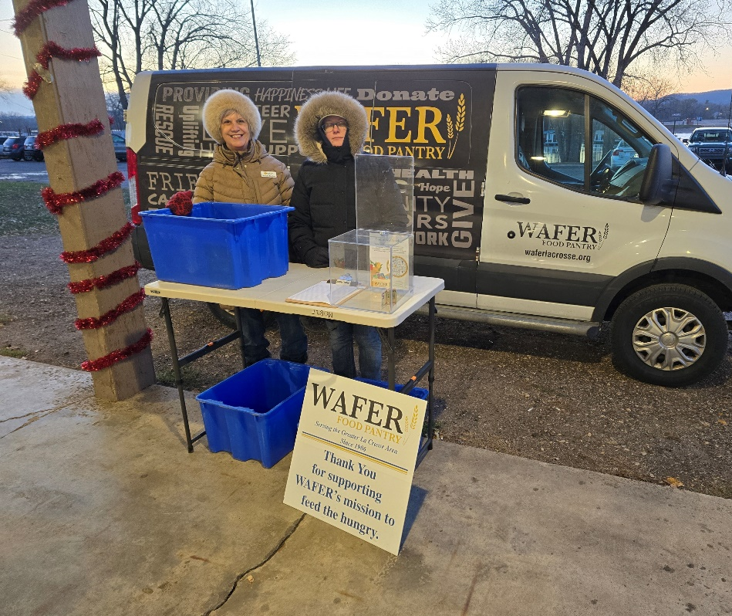
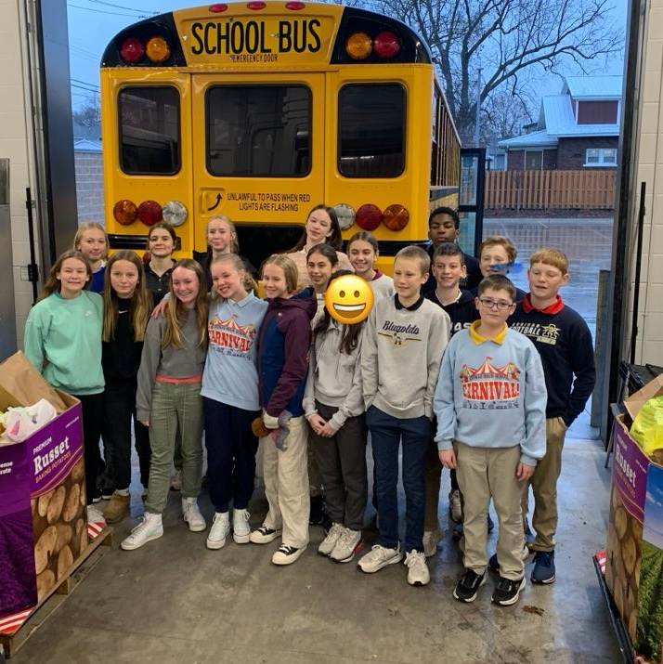
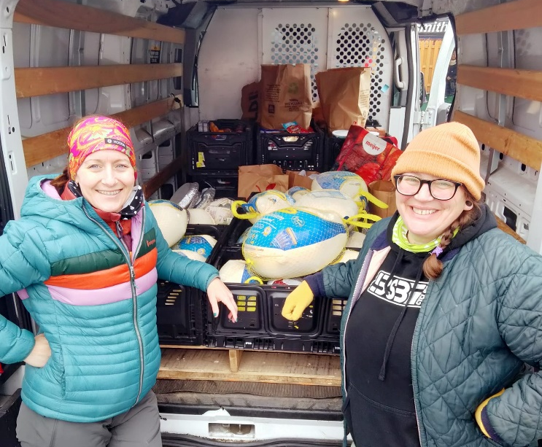
Organize.
Invite us to attend your community event like “Lighting Up the North Side” – to provide resource information and/or collect food.
Engage your coworkers, congregation, service club, or school like student leaders at Aquinas Middle School do annually for their “Stuff the Bus” campaign.
Coordinate a food/fundraising event like Smith’s Bike Shop and Blue Steel Bike held, “Cranksgiving”, a by-bike food scavenger hunt.
Notes:
In addition to these ideas, you can find a food drive kit on the website for suggestions and resources when planning your event. The materials even provide themed drive ideas such as Taco Tuesday (collecting taco shells, sauce, seasonings), Breakfast (cereal, cereal bars, pancake mix), Holiday (cranberry sauce, stuffing, green beans, cream soup), Pizza Party (crust packet, sauce, pepperoni). Get creative, make it fun, engage a team. In the past there have been some really unique ideas:
A Packers vs Vikings competition at a local church. Congregation members put bags of canned goods on table of the team they thought would win the big game. In the end, WAFER wins too by being the recipient of the canned goods.
Children at local schools do a “souper” job collecting canned soup for our families.
Building Christmas tree out of canned goods during the holidays.

Slide 9
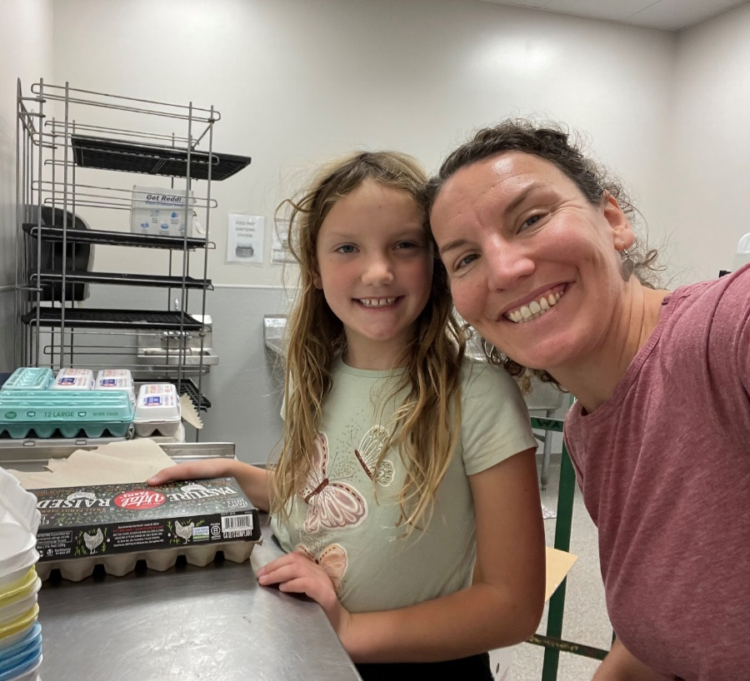
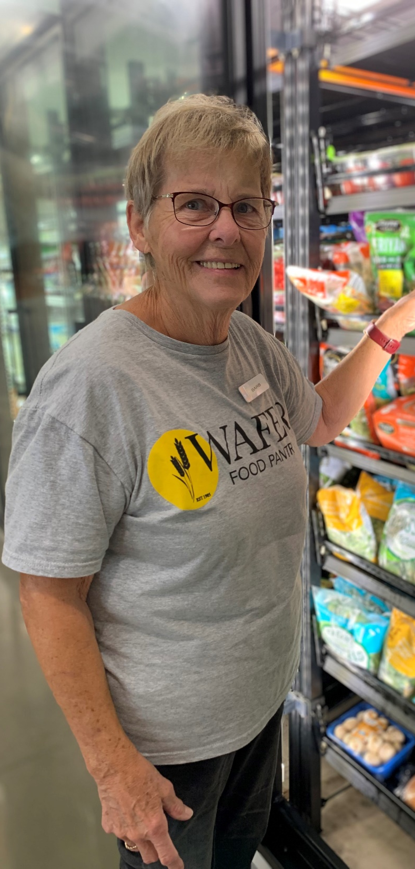
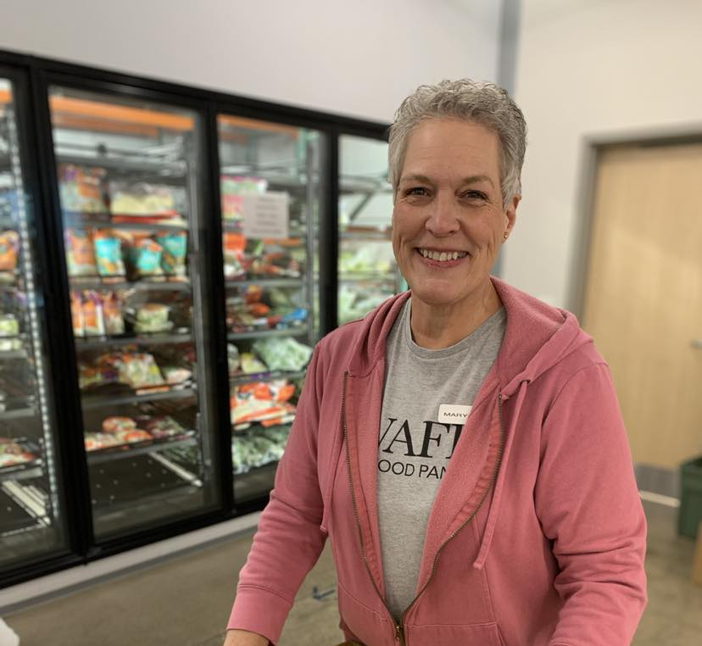
Volunteer. Serve the community, make a difference. Build relationships. Enjoy camaraderie.
Notes:
Volunteering looks different for everyone. Some volunteers give one day a month for a special project, others volunteer the same day(s) each week. There are many needs to be filled – stocking, sorting, receiving deliveries, repacking bulk donations, assisting shoppers, and more.

Slide 10
Do you have questions or want to get involved today? Call the office (608-782-6003, x3), email info@waferlacrosse.org, or find more information at waferlacrosse.org.

